Slide 1

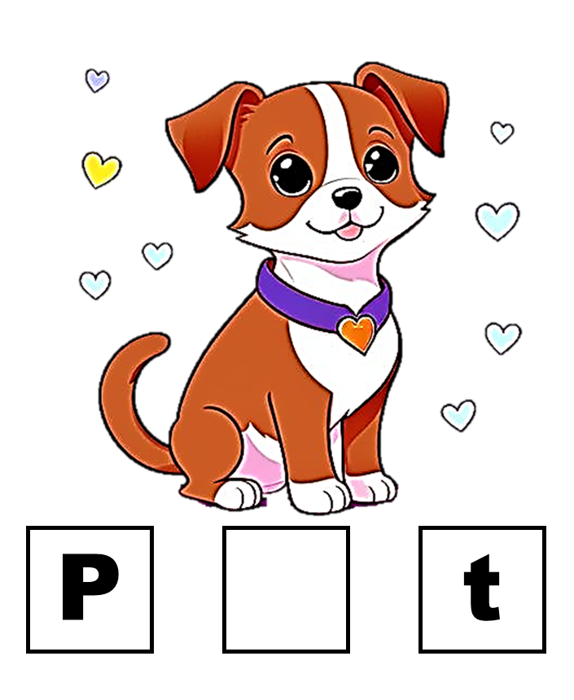

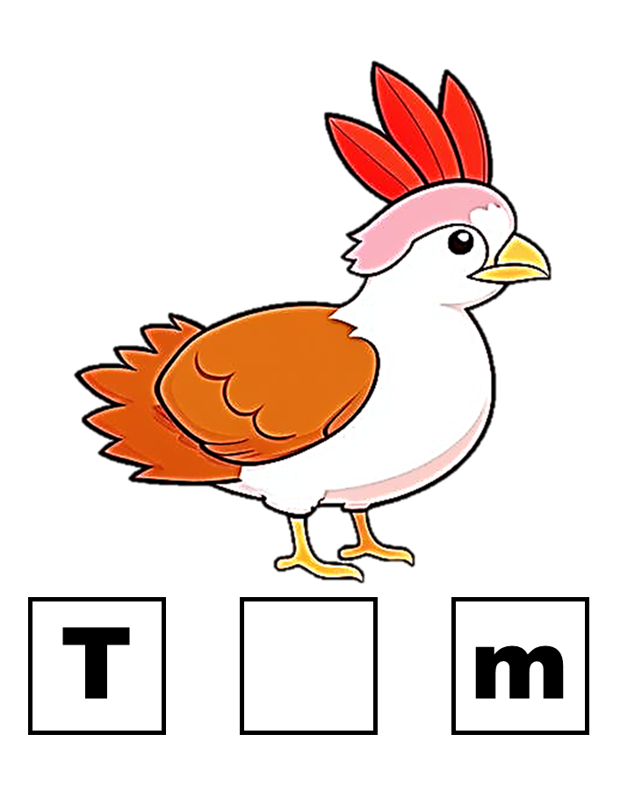
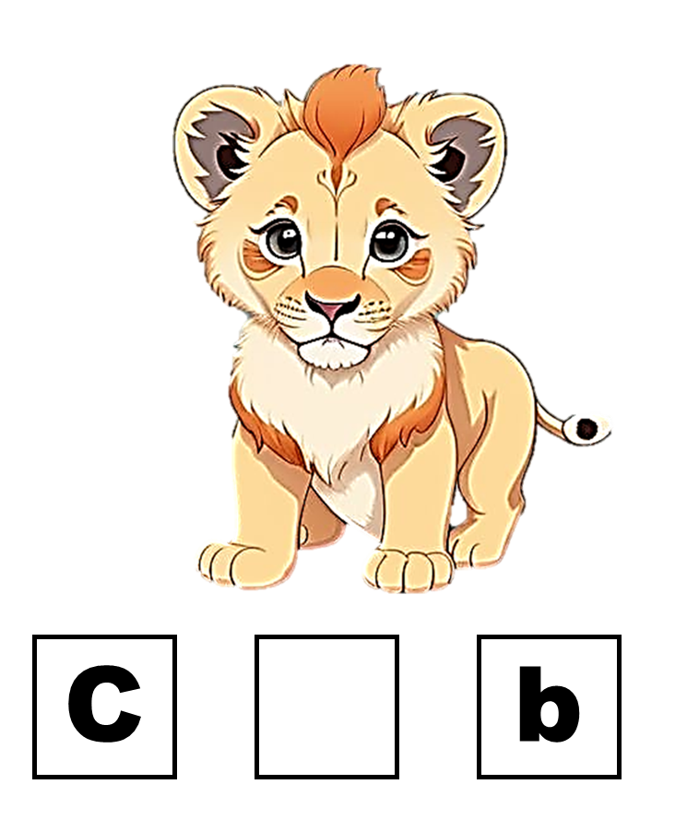
Vowel Comprehension
Workbook

Slide 2
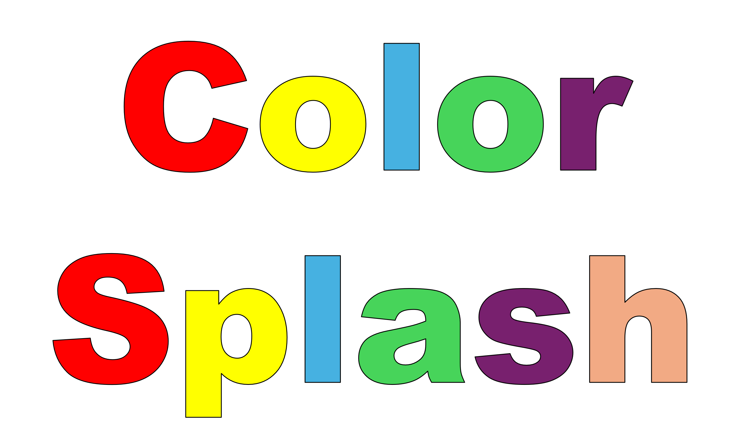

Blossomings.github.io
C
t
Color Splash
a
e
i
o
u

Slide 3

Blossomings.github.io
P
g
Color Splash
a
e
i
o
u

Slide 4

Blossomings.github.io
P
t
Color Splash
a
e
i
o
u

Slide 5
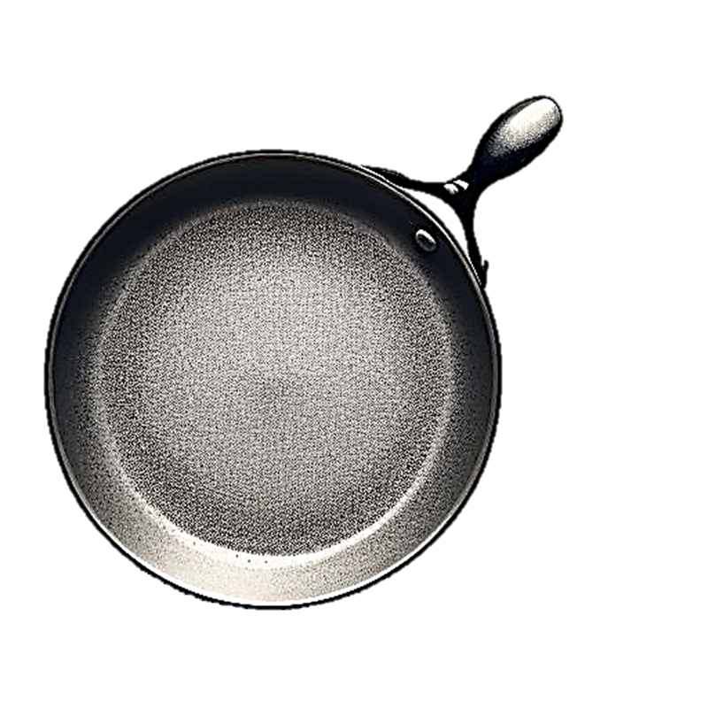
Blossomings.github.io
P
n
Color Splash
a
e
i
o
u

Slide 6
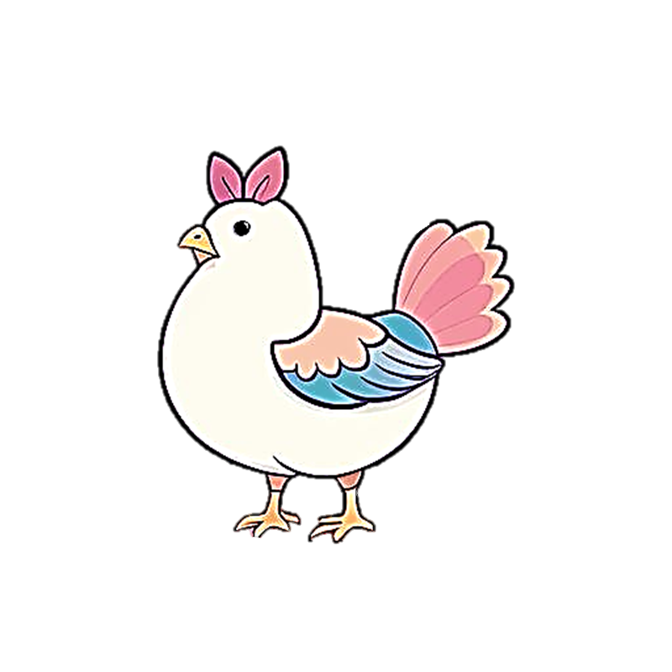
Blossomings.github.io
H
n
Color Splash
a
e
i
o
u

Slide 7

Blossomings.github.io
B
g
Color Splash
a
e
i
o
u

Slide 8
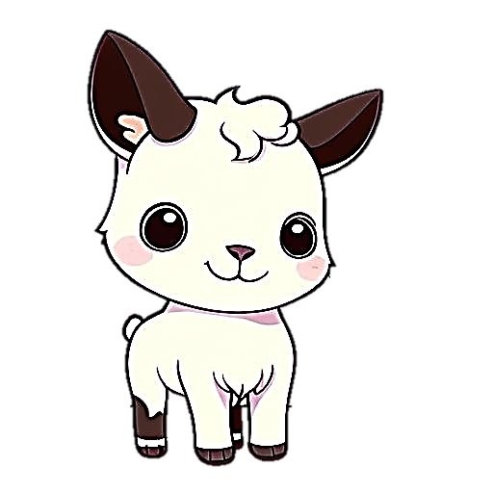
Blossomings.github.io
K
d
Color Splash
a
e
i
o
u

Slide 9


Blossomings.github.io
P
t
Color Splash
a
e
i
o
u

Slide 10
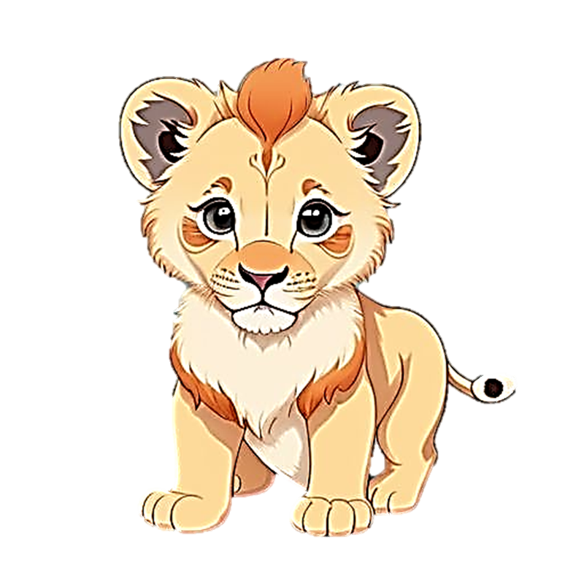

Blossomings.github.io
C
b
Color Splash
a
e
i
o
u

Slide 11
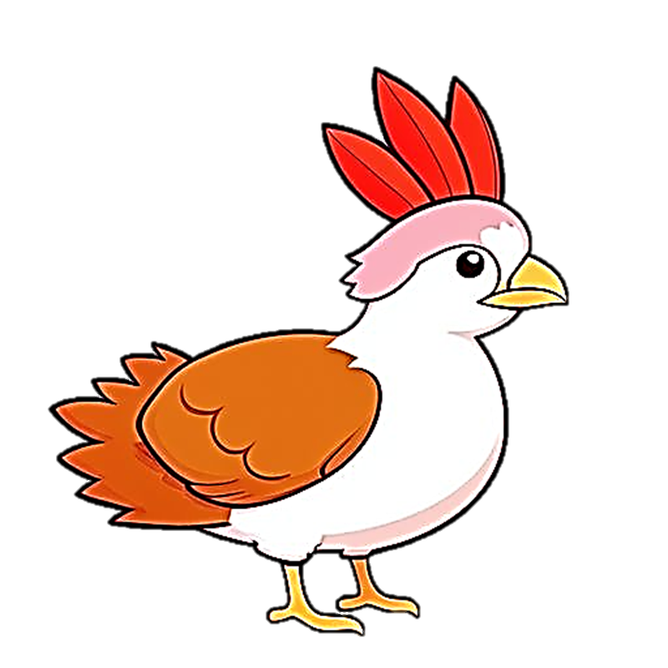
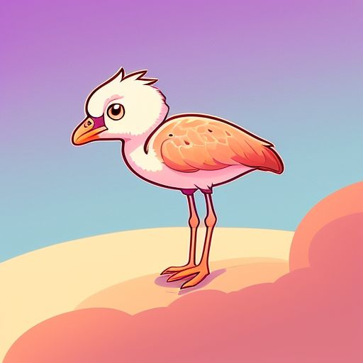
Blossomings.github.io
T
m
Color Splash
a
e
i
o
u

